Slide 1
01
Digital competences – the key to modernising education
Łukasz Tomczyk Assoc. Prof.
Jagiellonian University, Cracow, Poland

Slide 2
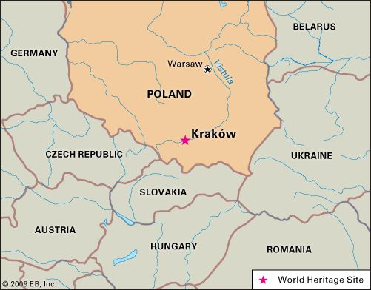
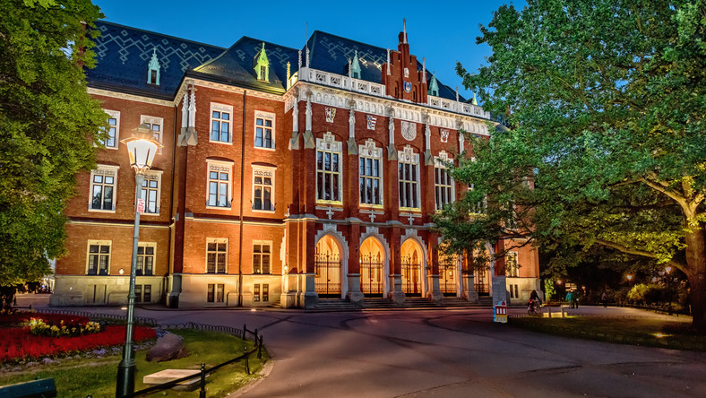
Poland

Slide 3
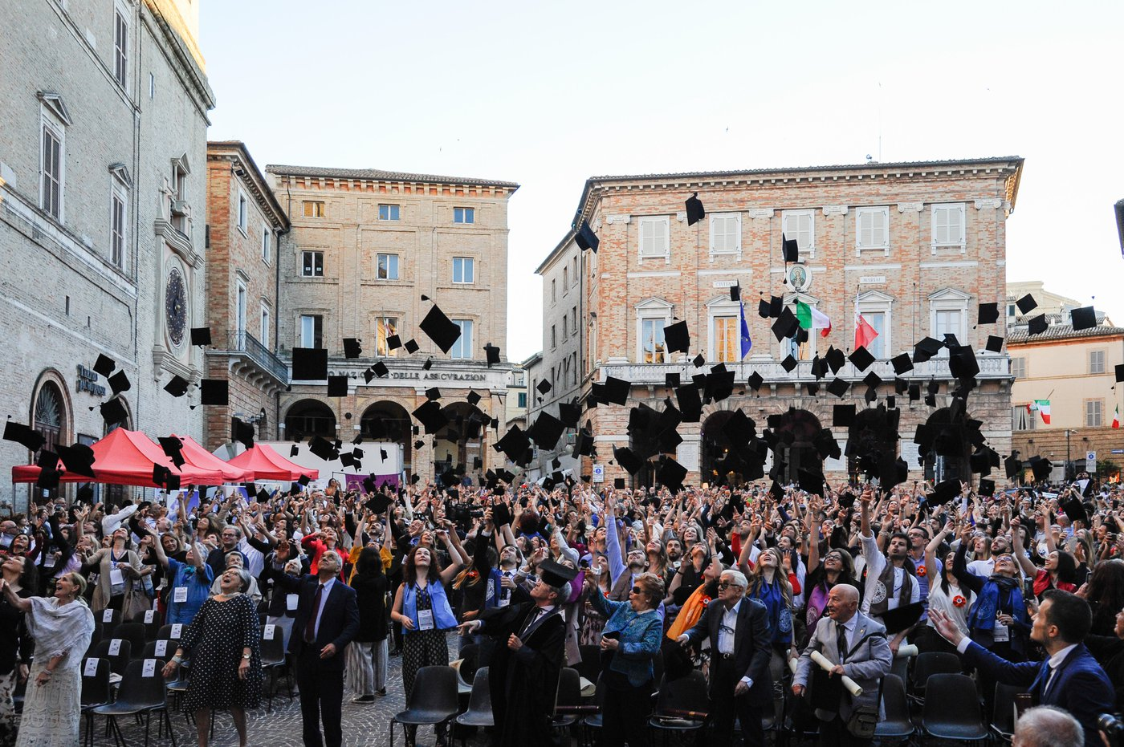
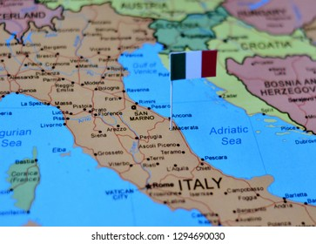
Italy

Slide 4
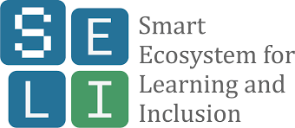
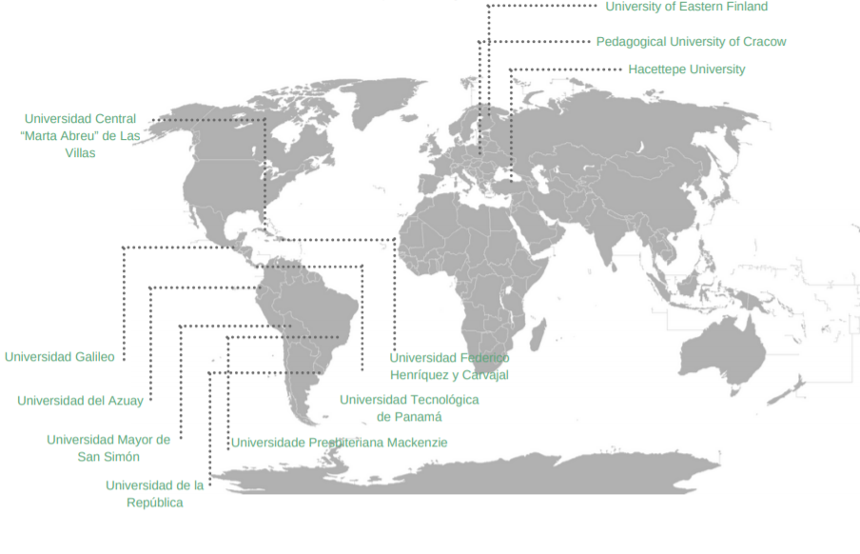
Current & previous research

Slide 5
Rethinking Media Literacy and Digital Skills in Europe

Slide 6
01
Something natural, one of the basic skills.
02
Determining quality of life
Digital literacy
03
Required in the labour market.
04
Meeting needs.
05
Age group-specific definition

Slide 7
Digital literacy
02
ICT usage
Websites
Hardware
Software
Reflection
How do the media change our behaviour?

Slide 8
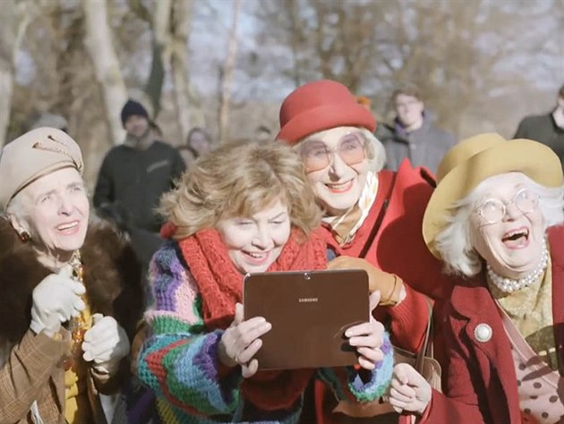
Digital literacy and needs

Slide 9
03
Each profession has a slightly different model of digital literacy

Slide 10
Media pedagogy
Digital competences and paradigms
The opportunity paradigm
Effectiveness of ICT use in education
The risk paradigm
E-threats: cyberbullying, piracy, sexting…

Slide 11
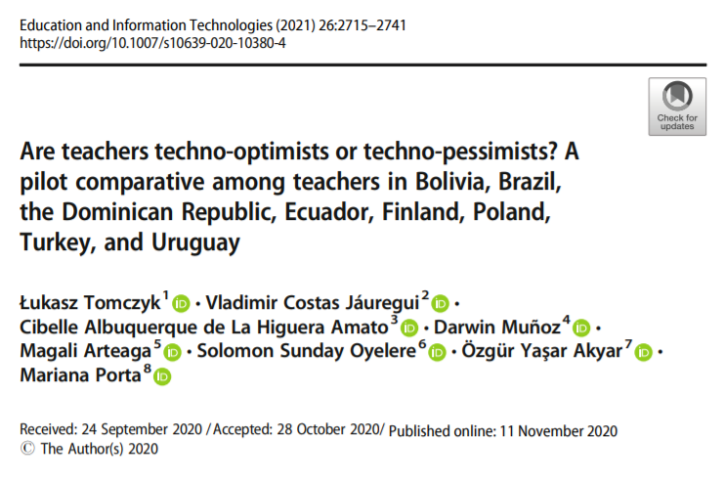
Technooptimists
ICT = high quality
Technopesimists
ICT in education = problems

Slide 12
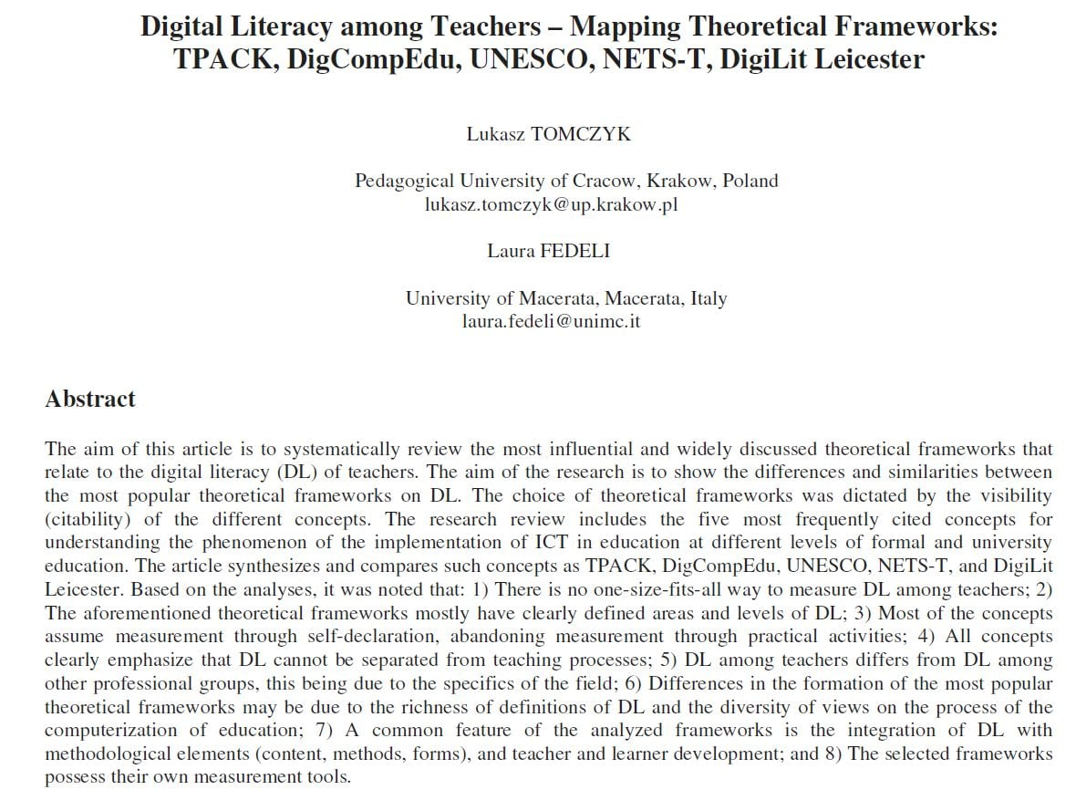

Slide 13
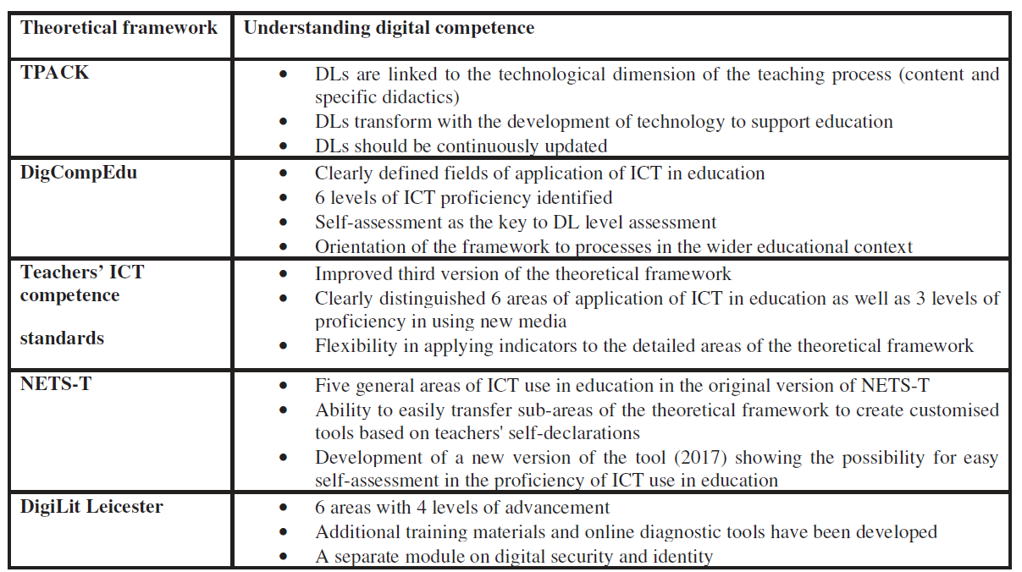

Slide 14
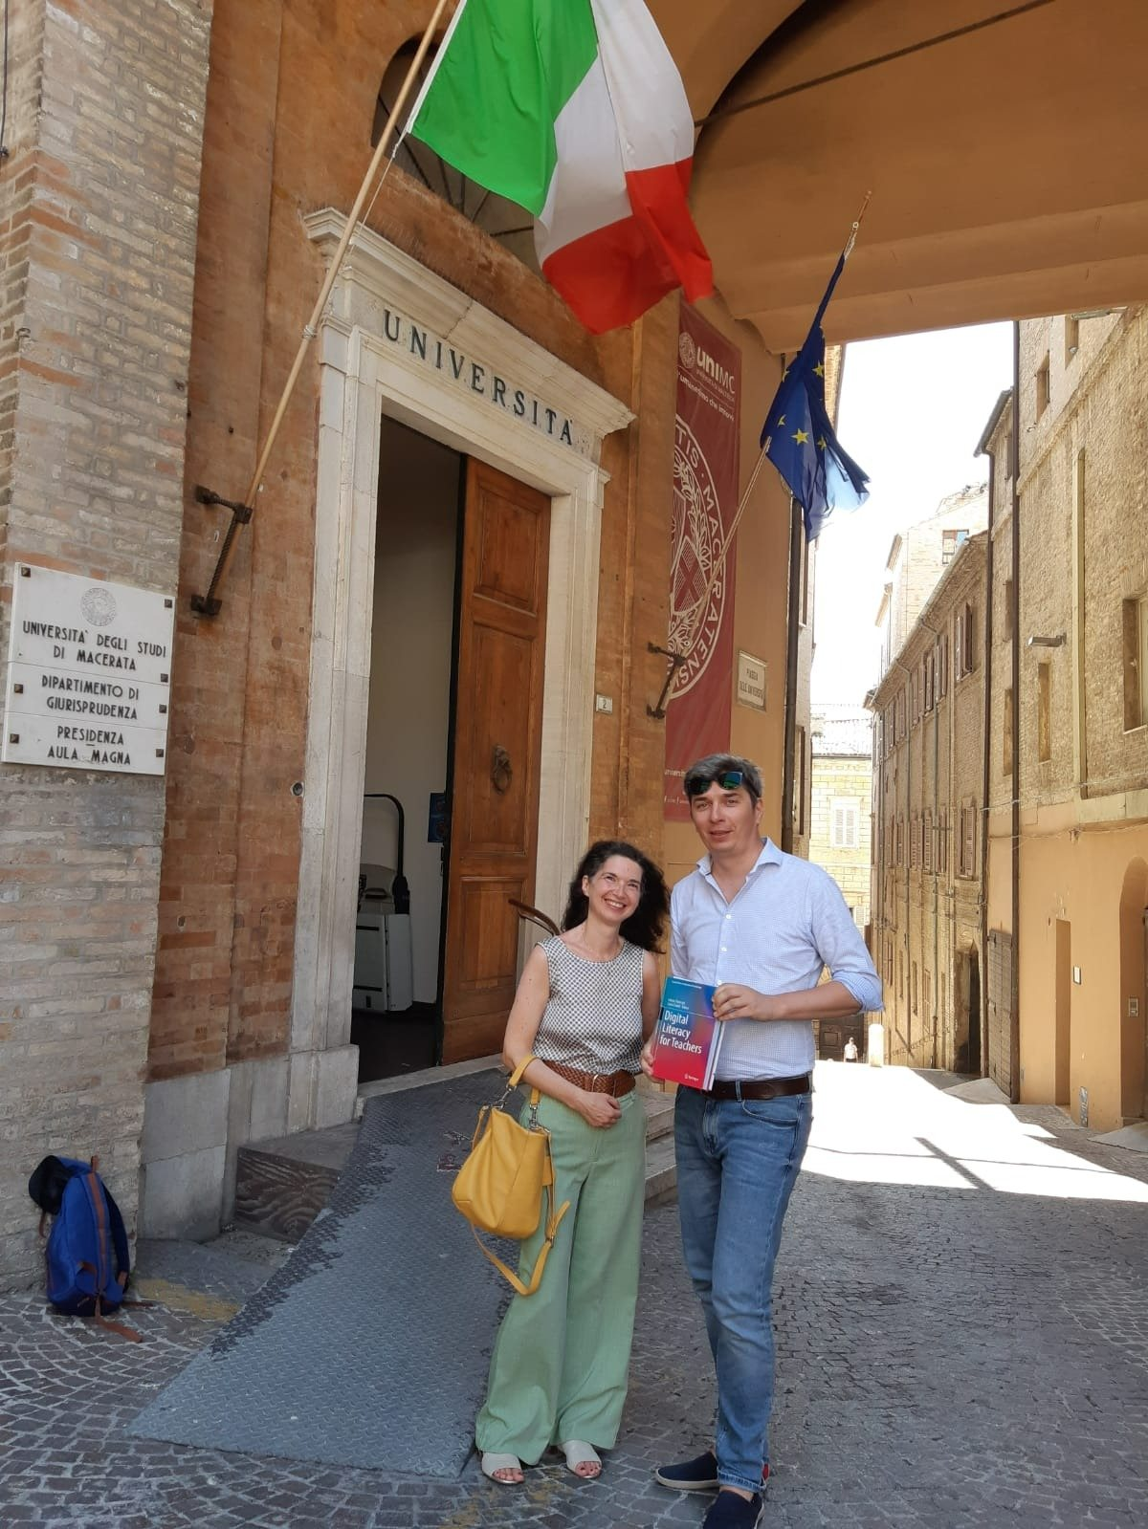

Slide 15
Systematic analysis 2001 – 2021 PL
PRISMA
EBSCO, WOS, SCOPUS, Google Scholar
Polish and English language
Reviewed Articles
Pre-service teachers

Slide 16
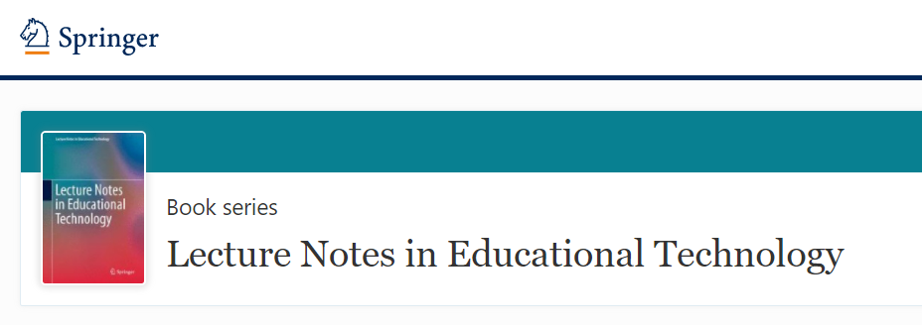
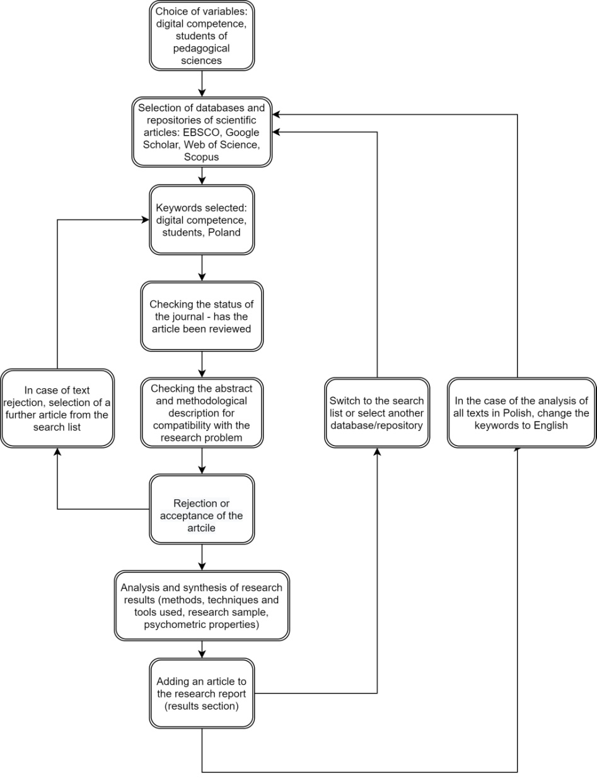

Slide 17
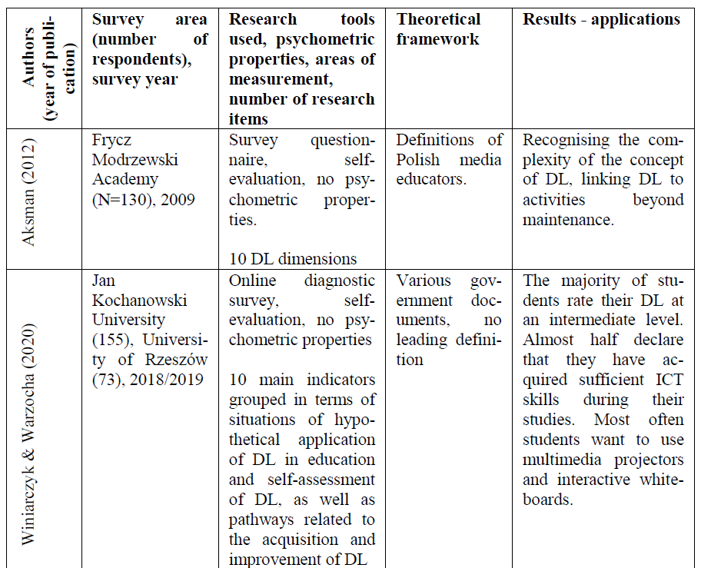

Slide 18
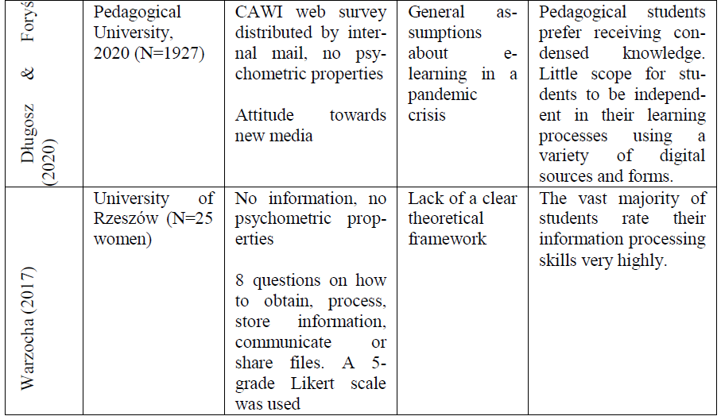

Slide 19
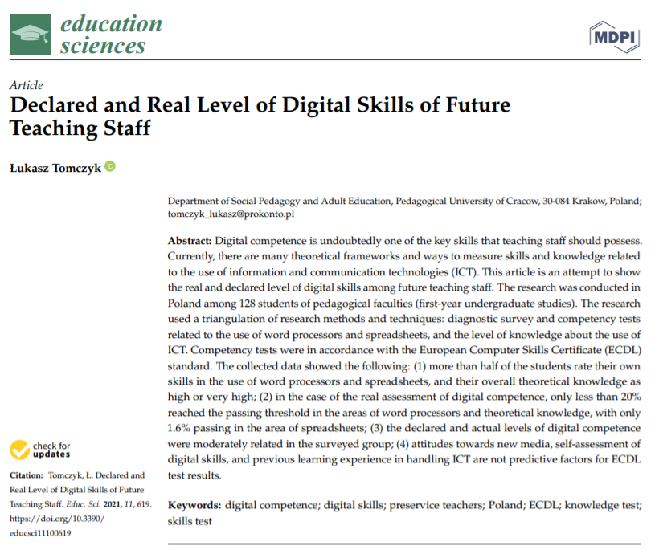

Slide 20
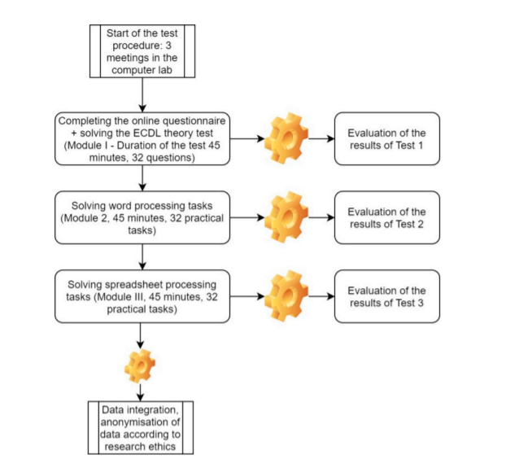

Slide 21
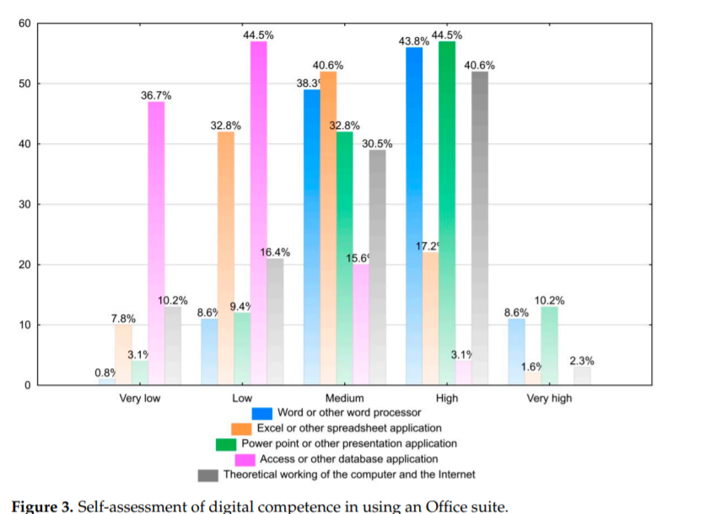

Slide 22
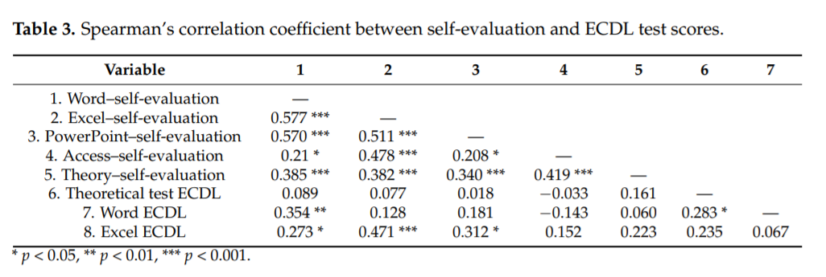
20%
1.6%

Slide 23
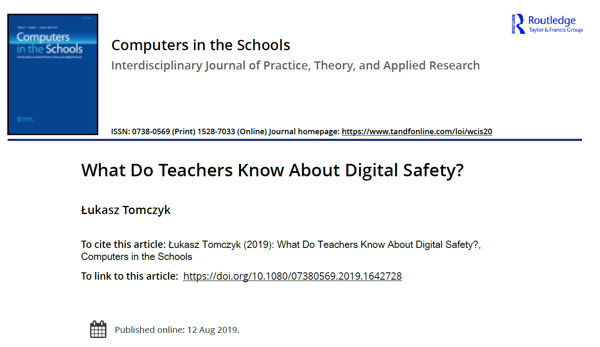
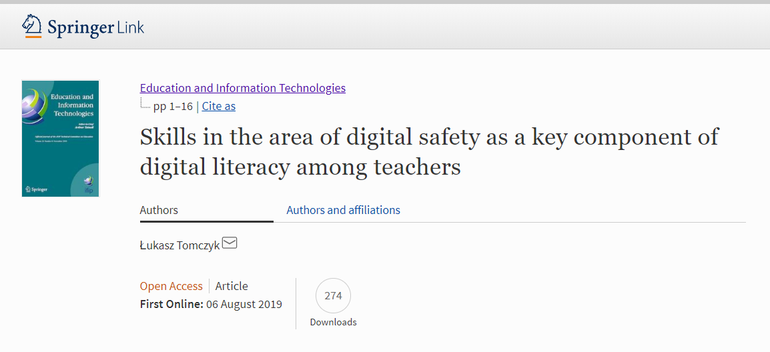

Slide 24
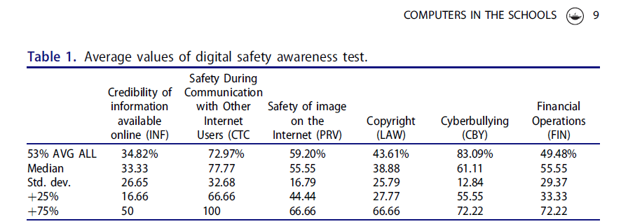
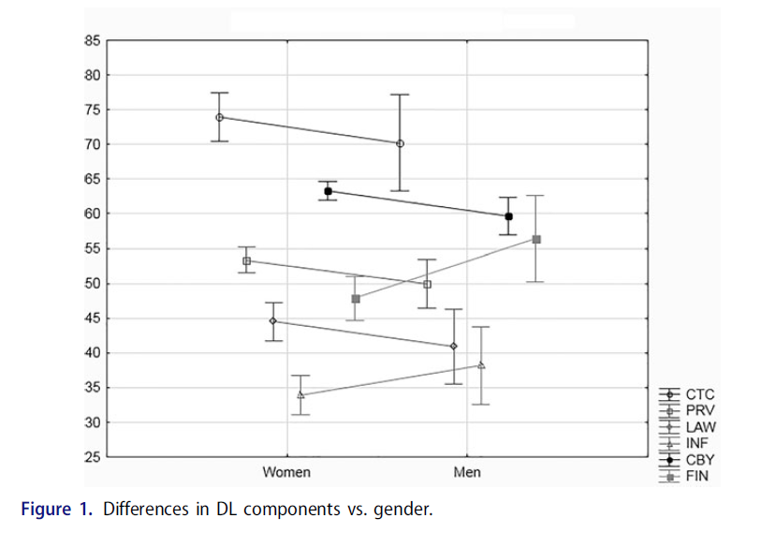

Slide 25
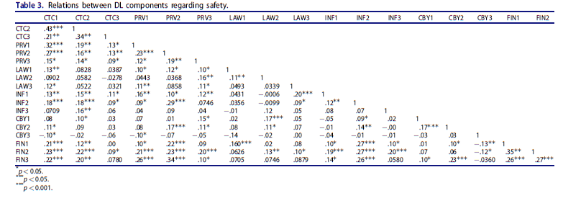

Slide 26
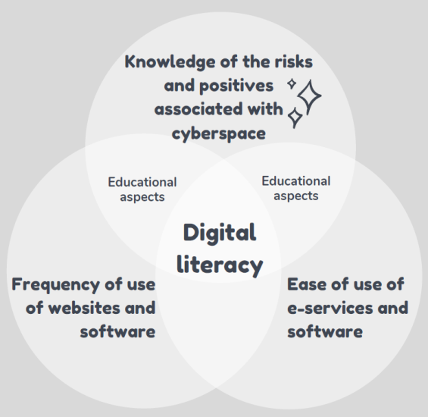
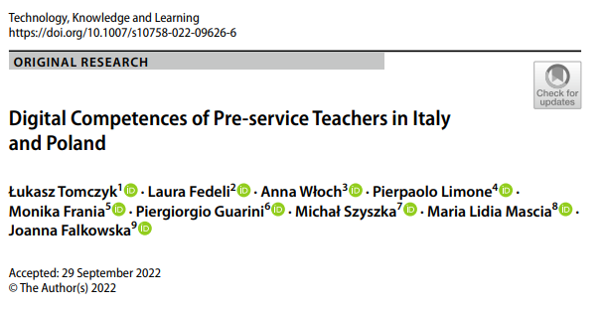
New research 2022 IT-PL
The research was conducted in the first half of 2022 using stratified sampling in both countries (N=1209, IT=604, PL=605)

Slide 27
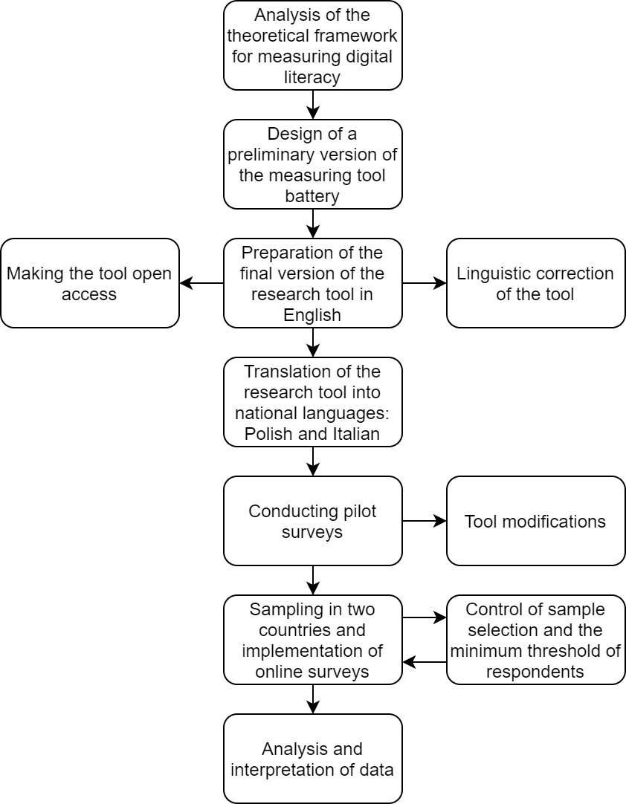

Slide 28
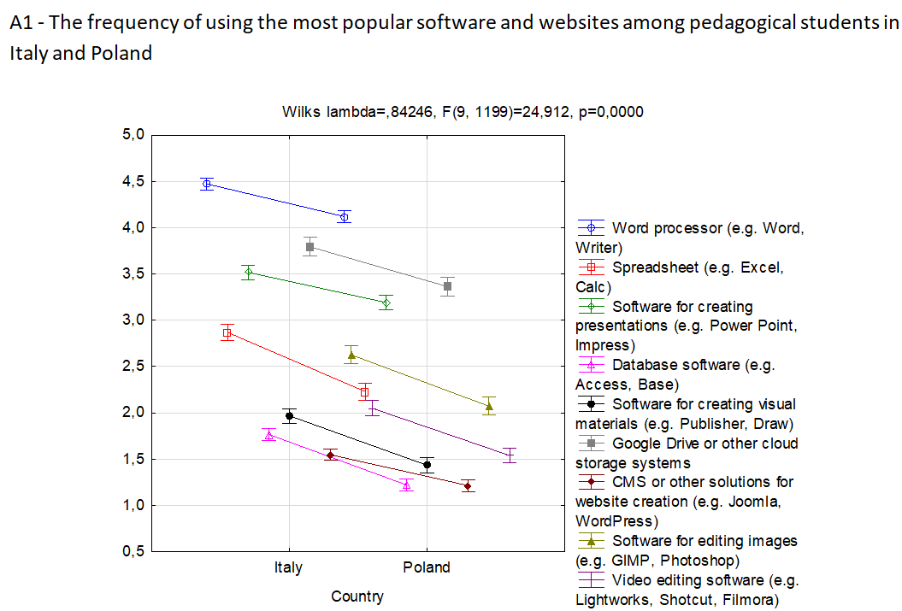

Slide 29
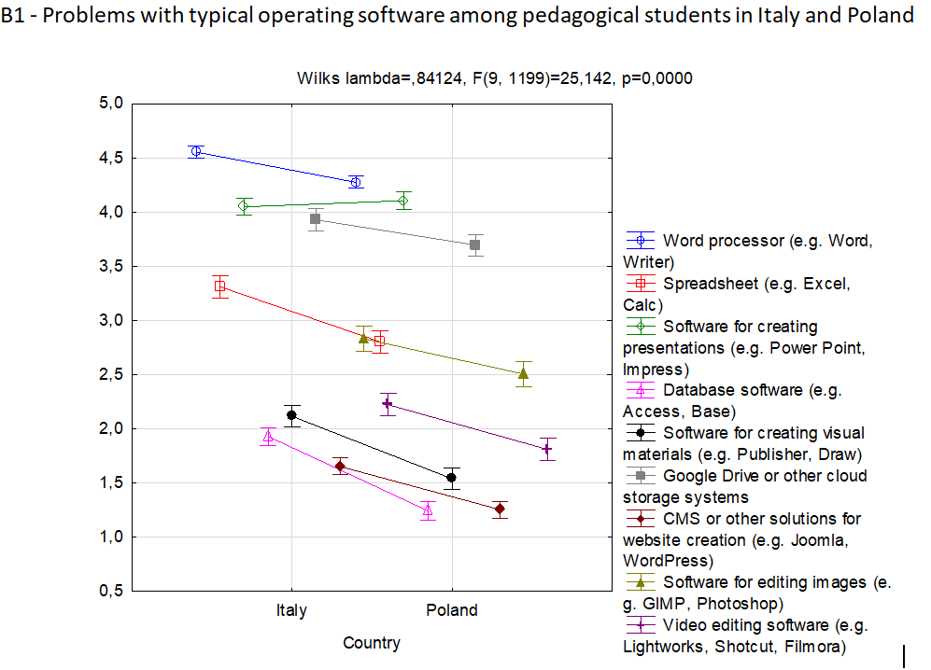

Slide 30
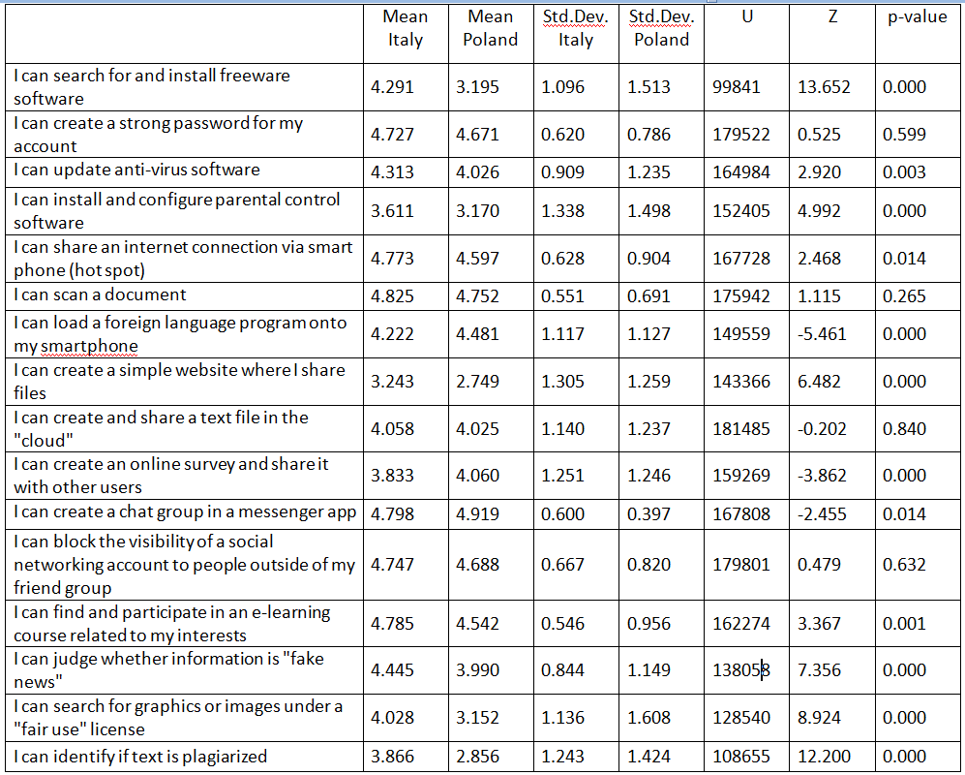

Slide 31
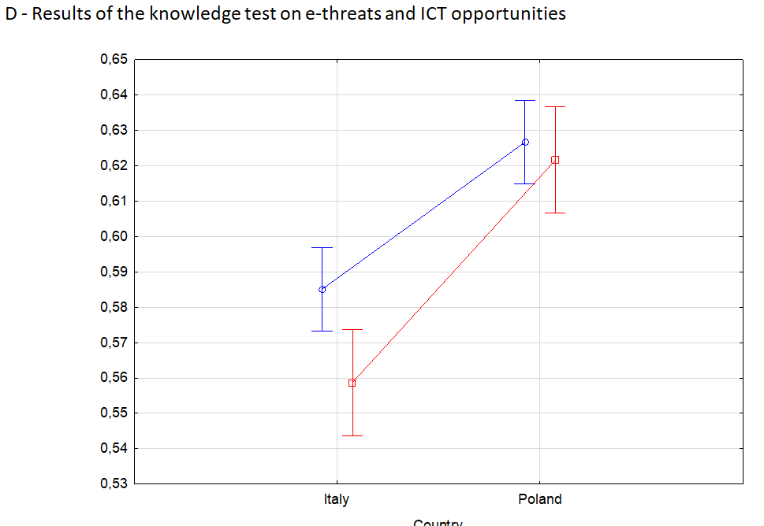

Slide 32
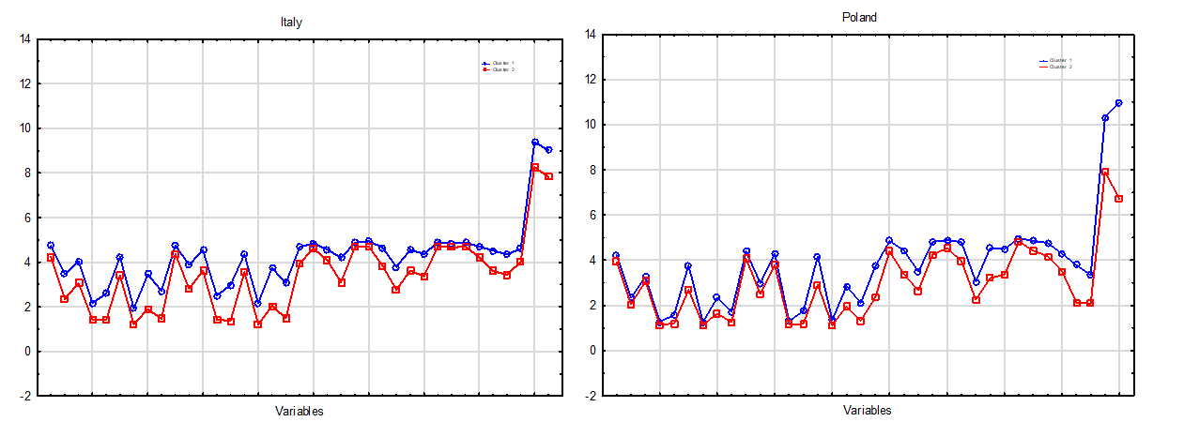
ITALY: Cluster number 1 (N=279, 46.19%) POLAND: Cluster number 1 (N=371, 61.32%)

Slide 33
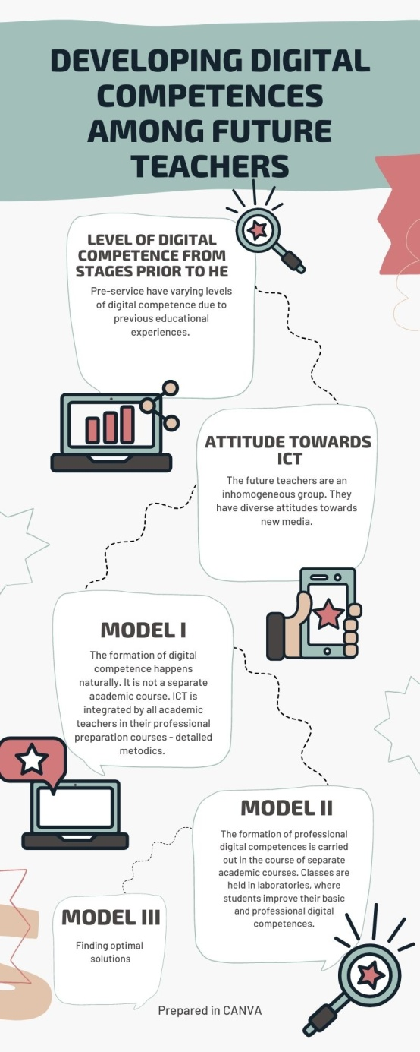

Slide 34
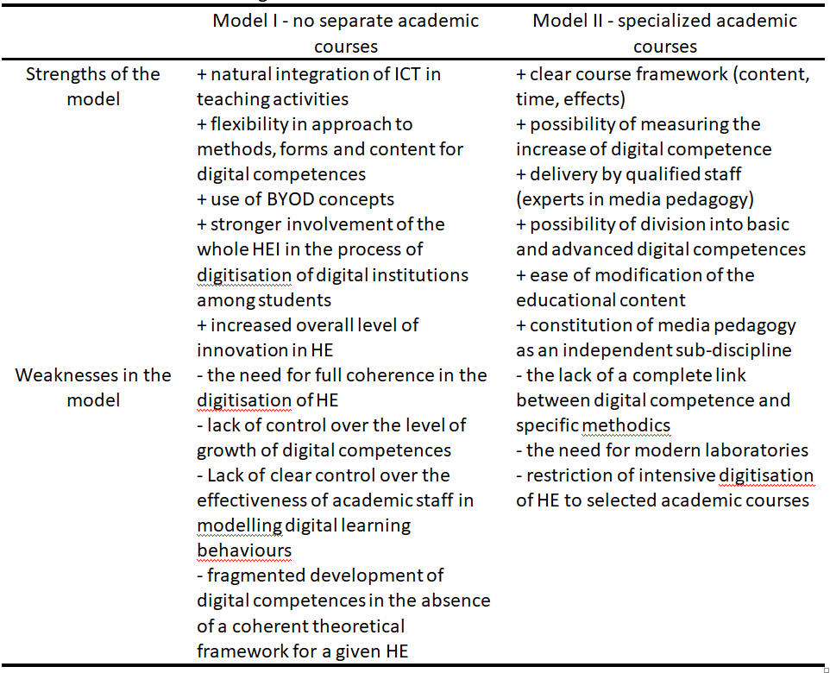

Slide 35
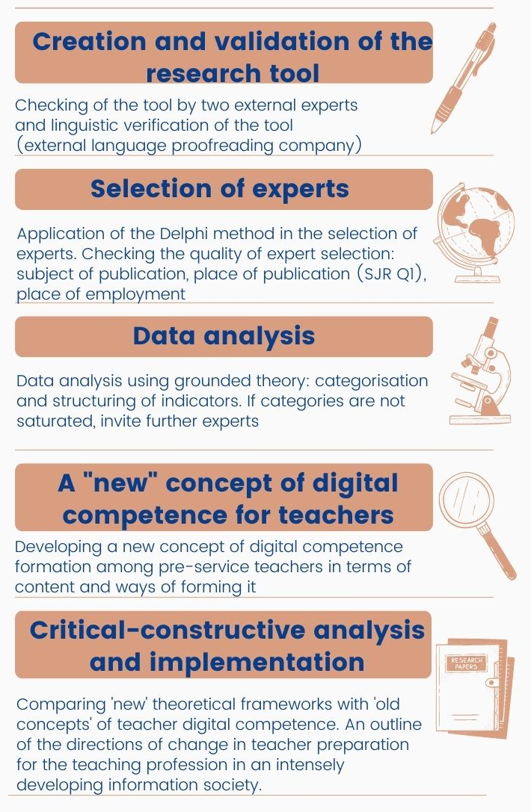
Qualitative research 2022 - DELPHI
Digital competences – experts model
How to shape digital competences among pre-service teachers

Slide 36
Short: 0-5 years; Medium: 6-15; Long: over 15 years
Numer of respondent | Country | Gender | Index H | Seniority *
R1 | Spain | Male | 24 | Medium
R2 | Slovakia | Male | 12 | Medium
R3 | Australia | Female | 10 | Medium
R4 | Serbia | Male | 10 | Medium
R5 | Norway | Female | 22 | Medium
R6 | Cyprus | Male | 33 | Long
R7 | Spain | Male | 27 | Medium
R8 | Tanzania | Male | 10 | Medium
R9 | Sweden | Male | 19 | Long
R10 | Czechia | Male | 21 | Long
R11 | Indonesia | Male | 16 | Long
R12 | India | Male | 23 | Long
R13 | Brasil | Male | 23 | Long
R14 | Thailand | Male | 10 | Short
R15 | Israel | Male | 15 | Long
R16 | Greece | Female | 18 | Long
R17 | Qatar | Female | 10 | Medium
R18 | Canada | Male | 15 | Long
R19 | Oman | Male | 15 | Long
R20 | Switzerland | Male | 22 | Long
R21 | Italy | Female | 13 | Short
R22 | Latvia | Female | 17 | Long
R23 | United States | Male | 30 | Long
R24 | Iran | Male | 12 | Medium
R25 | Turkey | Female | 16 | Short
R26 | Taiwan | Male | 13 | Short
R27 | Poland | Male | 14 | Long
R28 | Taiwan | Female | 13 | Short
R29 | Greece | Male | 13 | Short
R30 | Lithuania | Female | 12 | Short
R31 | Hong Kong | Male | 20 | Long
R32 | Chile | Male | 17 | Long
R33 | Hungary | Female | 14 | Medium
R34 | Hungary | Male | 11 | Long
R35 | China | Female | 20 | Medium

Slide 37
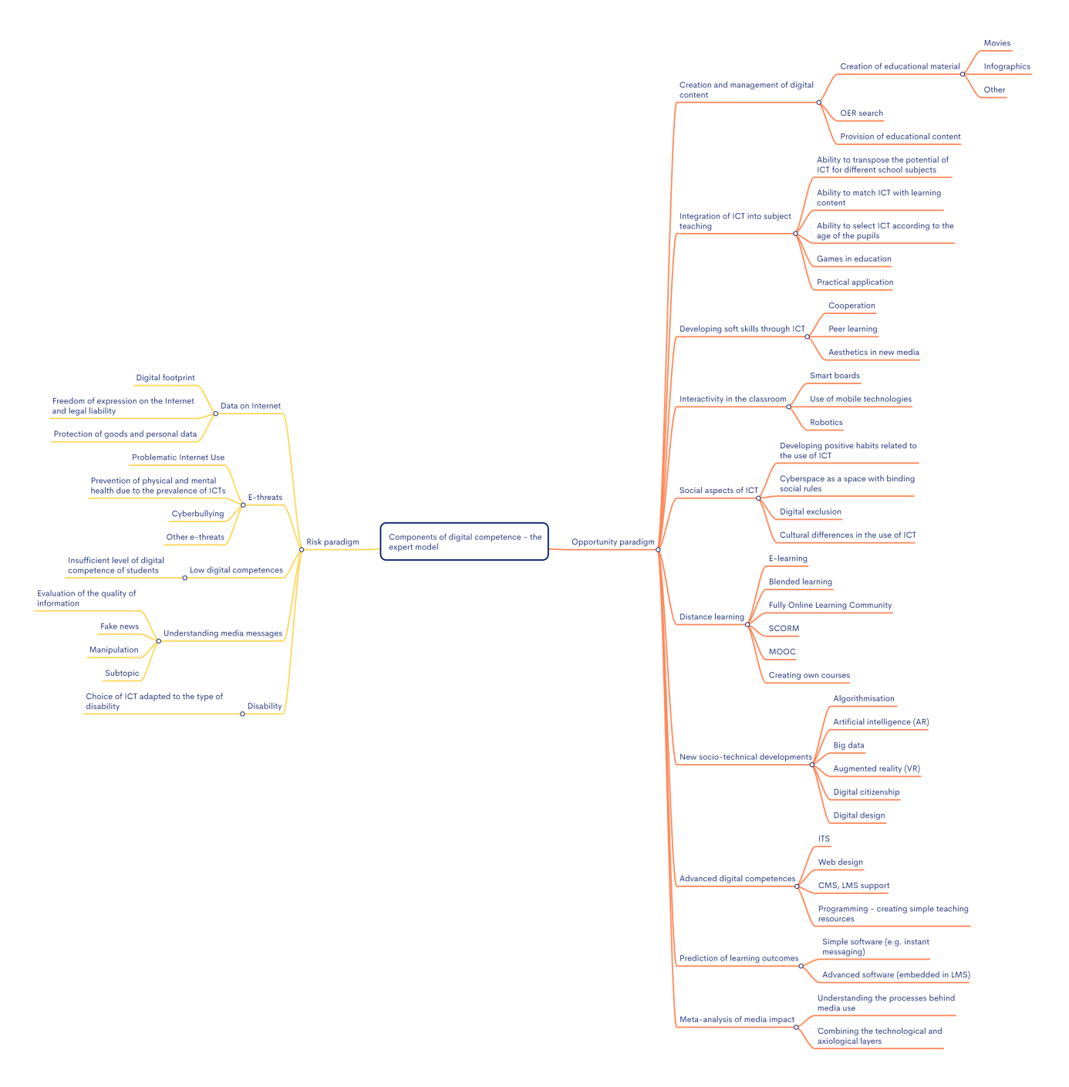

Slide 38
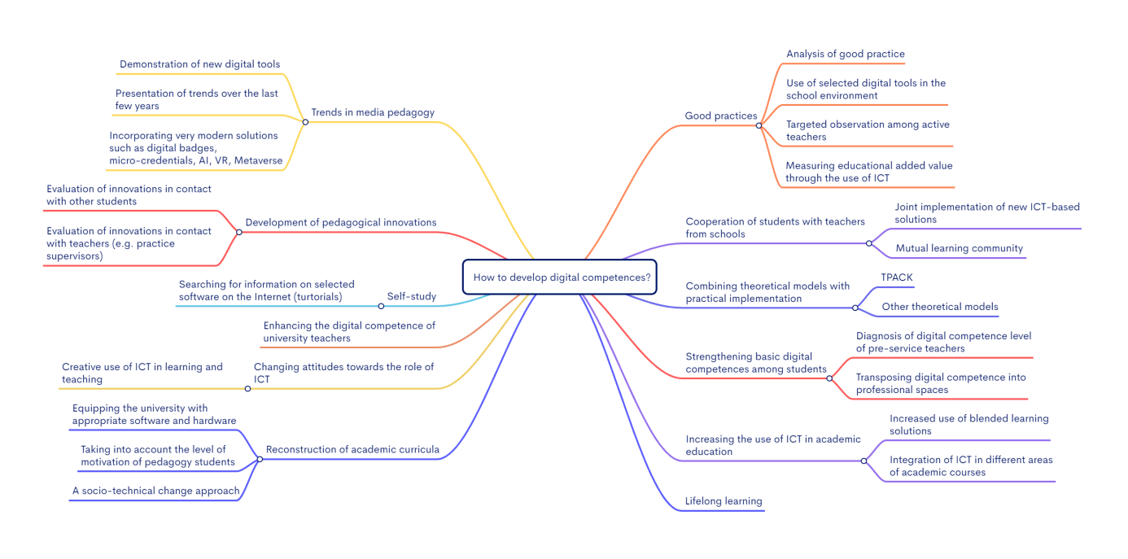

Slide 39
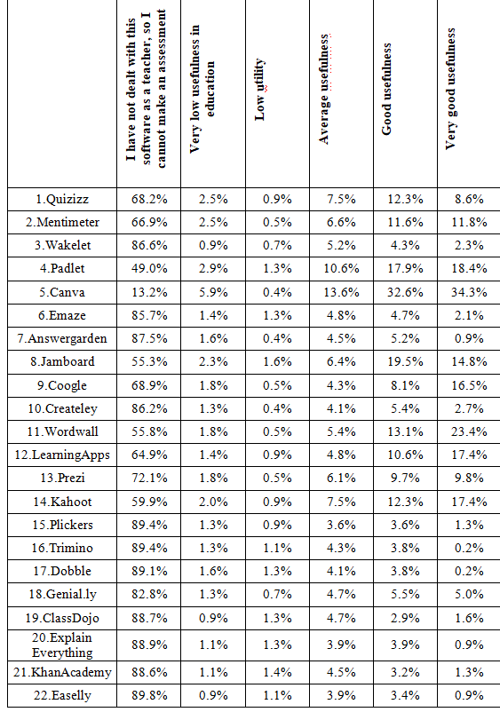
In-service teachers Italy (data 2022)

Slide 40
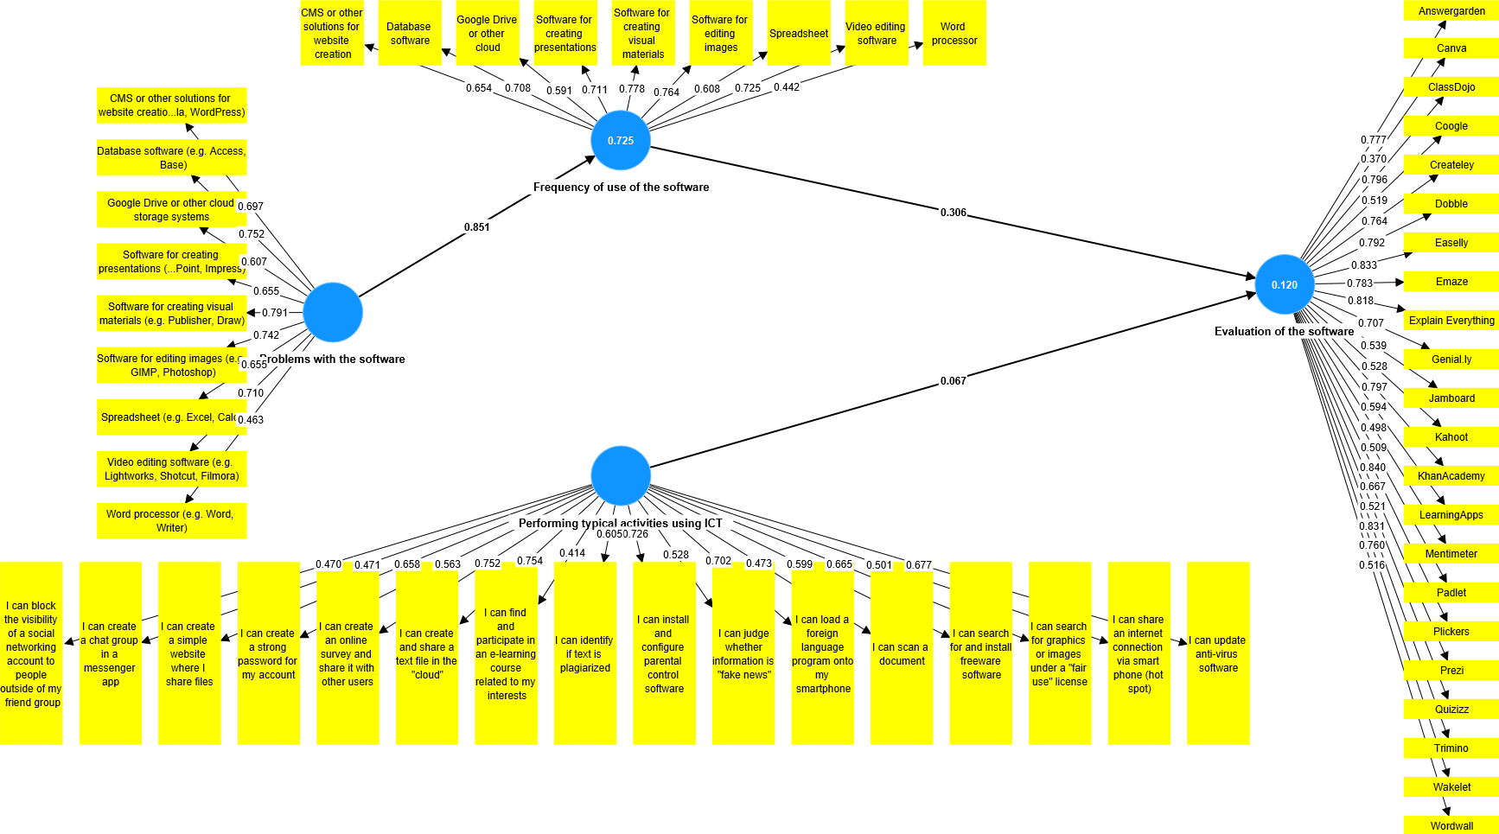
In-service teachers Italy

Slide 41
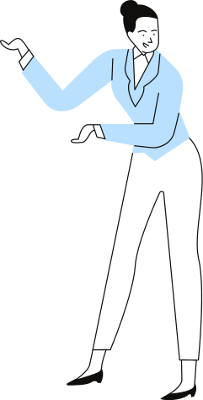
Conclusions 1/2
Measurement of DL is rare, theoretical analyses are preferred;
Dominated by quantitative techniques and tools mostly lacking theoretical frameworks and psychometric properties, based on a range of inconsistent indicators;
Occasionally DigCompEdu, TPACK, Eurostat typologies are used for measurement;
DL measurement is mostly based on students' self-declarations;

Slide 42
Conclusions 2/2
5) Studies are conducted in different centres without representative samples - usually small samples;
6) DL level is most often described as average or good;
7) Pedagogical students prefer typical information society software and services;
8) Attitude towards new media in education is diverse in this group;
9) There is a need to develop new standardized research tools measuring DL that compensate the Dunning-Kruger effect.

Slide 43
How to measure and how to define?
Longitudinal studies
Lack of comparative research
Imagine that other key competences are measured through self-declaration

Slide 44
New research (2024)
Digital competence of teachers and students of pedagogy
Digital competences in education and OER
Active creators instead of passive receivers
Digital hygiene among teachers
Problematic use of the Internet (smartphones) among pupils
ERC Starting Grant, Erasmus+ KA2, MSCA IF…

Slide 45
CONTACT
Łukasz Tomczyk
lukasz.tomczyk@uj.edu.pl
Mob. +48 503 738 988
Thank you for your attention

Slide 46
